Slide 1
MiQ Assignment
Mayank Joshi

Slide 2
OVERVIEW
The Data in hand is for the Sales for all users who made purchase online in the first half of Oct’17
Total Sales Revenue | 6,699,843.72 price units
Total Orders placed | 49,984 (excluding 15 undefined)
Total units sold | 101,305 units
Average unique order quantity | 2 units (approx.)
Revenue per order | 134 price units (approx.)

Slide 3
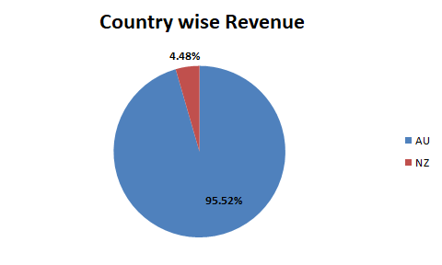
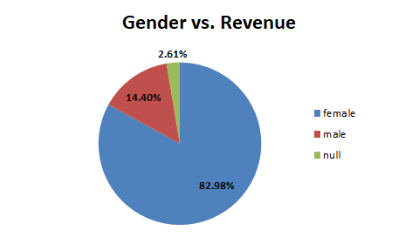
Australia (96%) contributes way more to the revenue than New Zealand.
Majority of the audience of the brand is comprised of Females (83%).

Slide 4
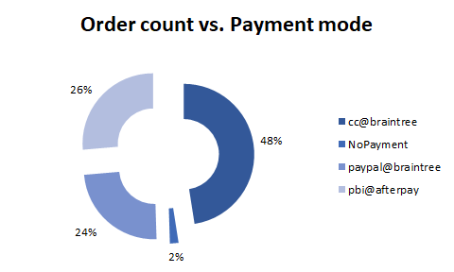
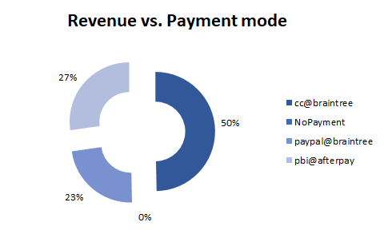
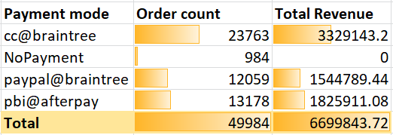
It is evident from the graphs that almost half of the users prefer paying via cc@braintree, followed by pbi@afterpay and paypal@braintree.

Slide 5
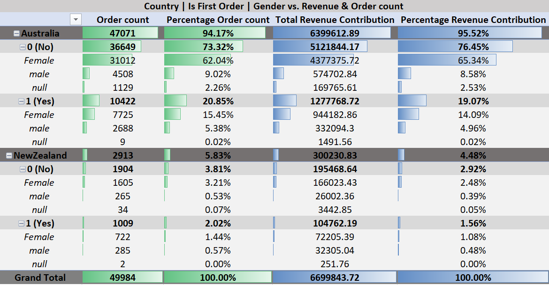
Multivariable analysis of Country, First Purchase Order and Gender with the Order count and Revenue
Australia contributes to more than 95% of 6,699,843 price units of revenue. Moreover, the majority of purchases made on the website are by Females (> 85%) and thus contributing to majority of the revenue.
Also, a key point to note is that the website has more than 79% repeat customers who contribute to more than 75% of the total revenue. Only around 23% of the customers placed their orders for the first time.

Slide 6
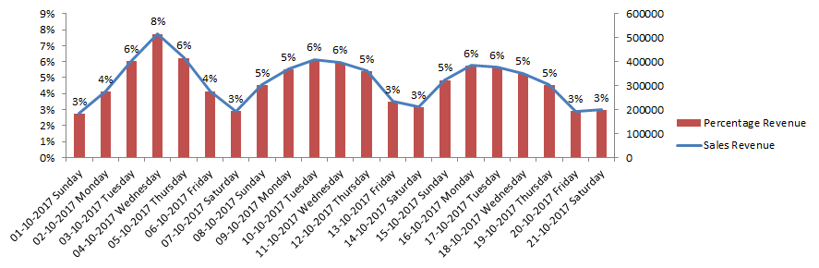
Date-Day vs. Sales Revenue
The above graph provides us with a clear picture of the Sales trend on the website.
Its very much evident that the users prefer to shop on the weekdays. Also, the maximum sales revenue was recorded on 4th October 2017 which was a Wednesday almost 8% of the total sales revenue. An interesting point to note is the low sales over the weekends. This is most probably because users tend to spend weekends outdoors because October November are the most pleasant months in the Asia Pacific region.

Slide 7
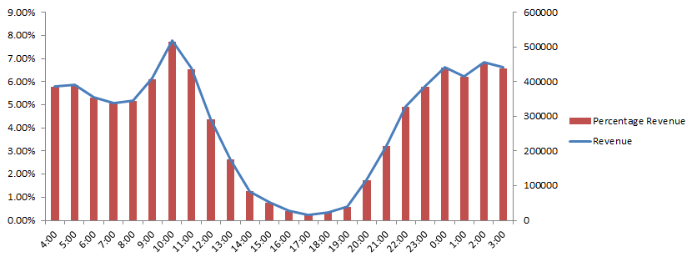
Time vs. Revenue
Percentage Revenue
Time
From the above chart one can easily make out that the users tend to place orders during late night and early morning. Here, the maximum sales revenue is recorded for 10a.m. i.e. almost 8% of the total revenue.

Slide 8
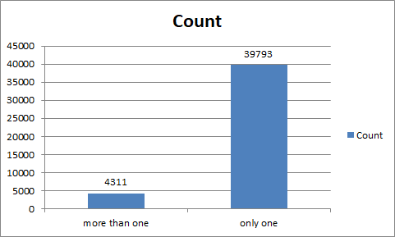
Purchasers analysis
90 % of the purchasers on the platform are single purchasers whereas around 10% of the purchasers are multiple purchasers.
A very peculiar observation about the multiple purchasers is that they have Not made the payment. Most probably these are credit purchases.

Slide 9
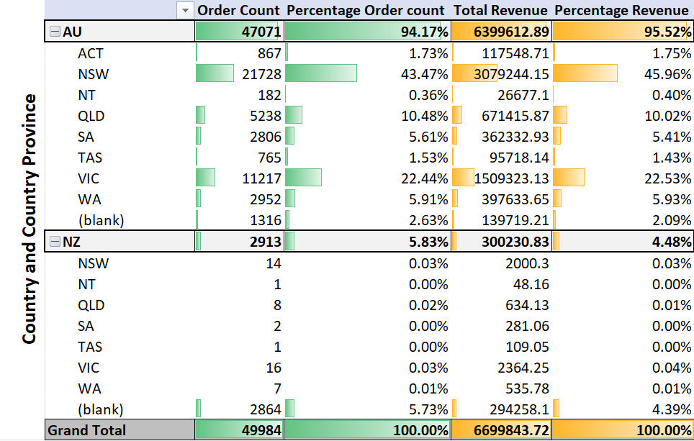
This visual provides us with a crystal clear picture of the Orders & Revenue contribution from the two Countries (Australia and New Zealand) and also drills down to show contribution from various Country Provinces.
We can easily make out that majority of the Revenue comes from Australia and in Australia too NSW contributes to almost half of the total revenue followed by VIC and QLD.
In New Zealand 4.39% of the revenue comes from Not specified country provinces.
A key point to note is that the Sales Revenue from each Province is directly proportional to the population of these provinces.

Slide 10
Market Basket Analysis
On performing Market Basket analysis I can conclude that the below mentioned are the top products which are likely to be purchased together by the users.
Heritage Bra | Heritage Tights
Belilze Balconette Bikini Top | Dominica High Waisted Briefs
Staple Longline Tee | Slater Shorts
Rope | Staple Shorts
Bikini | Customised Stretch Bralette
Orange Label Vintage Embroidery T-shirt | Acad Basic Crew Tee
Modern Cotton Bikini Briefs | Modern Cotton Bralette
Modern Cotton Thong | Modern Cotton Bralette
Pigment Tail Tee | Acad Basic Crew Tee

Slide 11
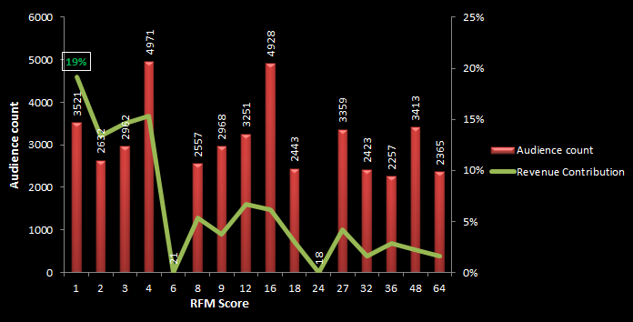
RFM Analysis
The visual below shows the segmentation of the audience on the basis of Revenue (16 segments). I used RFM (Recency, Frequency and Monetary) analysis to segment the audience.
The x-axis represents RFM score (the lower the better). As is evident that we have 3521 unique users who belong to the first and the best group i.e. they have the best scores (1) and so contribute the maximum to the Revenue (19%).

Slide 12
Media Strategy for targeting more users
While analyzing the dataset, we saw some alarming and equally important facts. The male contribution to the Revenue and the same from New Zealand is very low.
I strongly believe the brand should target Male audience in the following ways:
Promoting mens products on social media using influencers with deep reach
Providing discounts on mens products
Using affiliate marketing
Targeted ads
Staying relevant to men
Moreover the brand needs to be promoted in New Zealand too.
Same methods can be used here.
In today's times I believe Social Media and Influencers should be used to its maximum along with the regular conventional modes to increase the reach of the brand among different target customers at the same time the offers should be made more lucrative to attract maximum target users to the brand.
Category | Revenue Contribution
Male | 14.40%
New Zealand | 4.48%

